Slide 1
NDIS CHAMPIONS:
EMERGING GRASSROOTS LEADERS
The National Disability Insurance Scheme (NDIS)

Slide 2
Introduction
My name is…......and I am an NDIS Champion
Acknowledgement of Country

Slide 3
An overview of the NDIS

Slide 5
Who can access the NDIS?

Slide 7
The NDIS can support you even if you’re not eligible for funding
You may still be able to access disability and mainstream support in the community. Find information on how to build skills and capability and link to these services on the NDIS website at www.ndis.gov.au/people-disability/information-and-referral

Slide 8
When will the NDIS be available?

Slide 9
When will the NDIS be available?
The NDIS is being introduced in stages around Australia
Look up www.ndis.gov.au for the details in your area

Slide 10
Why do we need the NDIS?

Slide 11
Why do we need the NDIS?
People with disability have the same rights as everybody else
Everyones needs and goals are different
Old system was unfair and inefficient
Peace of mind for all Australians

Slide 12
Why an insurance scheme?
The NDIS is social insurance, not welfare
The NDIS takes a lifetime approach to support, investing in people early to improve their outcomes later in life

Slide 13
More about NDIS access

Slide 15
More about NDIS availability

Slide 16
When will the NDIS be available?
NSW – by local government area
VIC – by local government area
QLD – by local government area
SA – by age group (growing from 0-13yo)
TAS – by age group (growing from 25 yo)
ACT – whole territory roll out
NT – by local government area
WA – limited extension of trial site

Slide 17
More about formal reviews of NDIS decisions

Slide 18
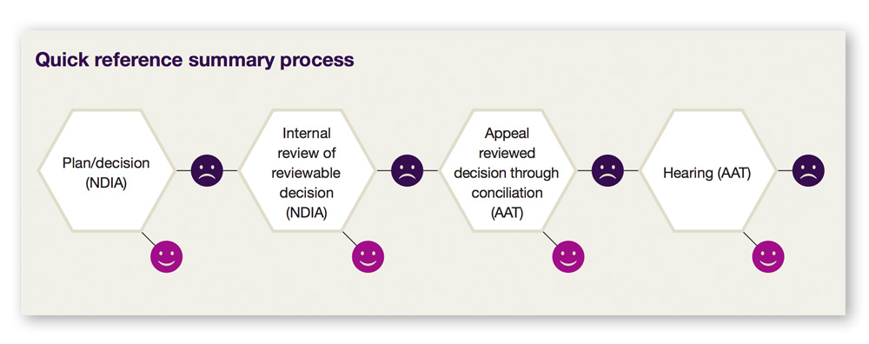
Formal reviews of NDIS decisions

Slide 19
More about why the
NDIS is needed

Slide 20
Why the NDIS is needed
Support is hard to get or not available at all
What support is available changes depending on where you live
Very little or no choice

Slide 21
More about an insurance scheme

Slide 27
The principles of the NDIS

Slide 28
Human rights based

Slide 29
Reasonable and necessary
Notes:
Map? With names of systems?

Slide 30
Choice and control

Slide 31
The dignity of risk

Slide 32
Common elements of a good plan

Slide 33
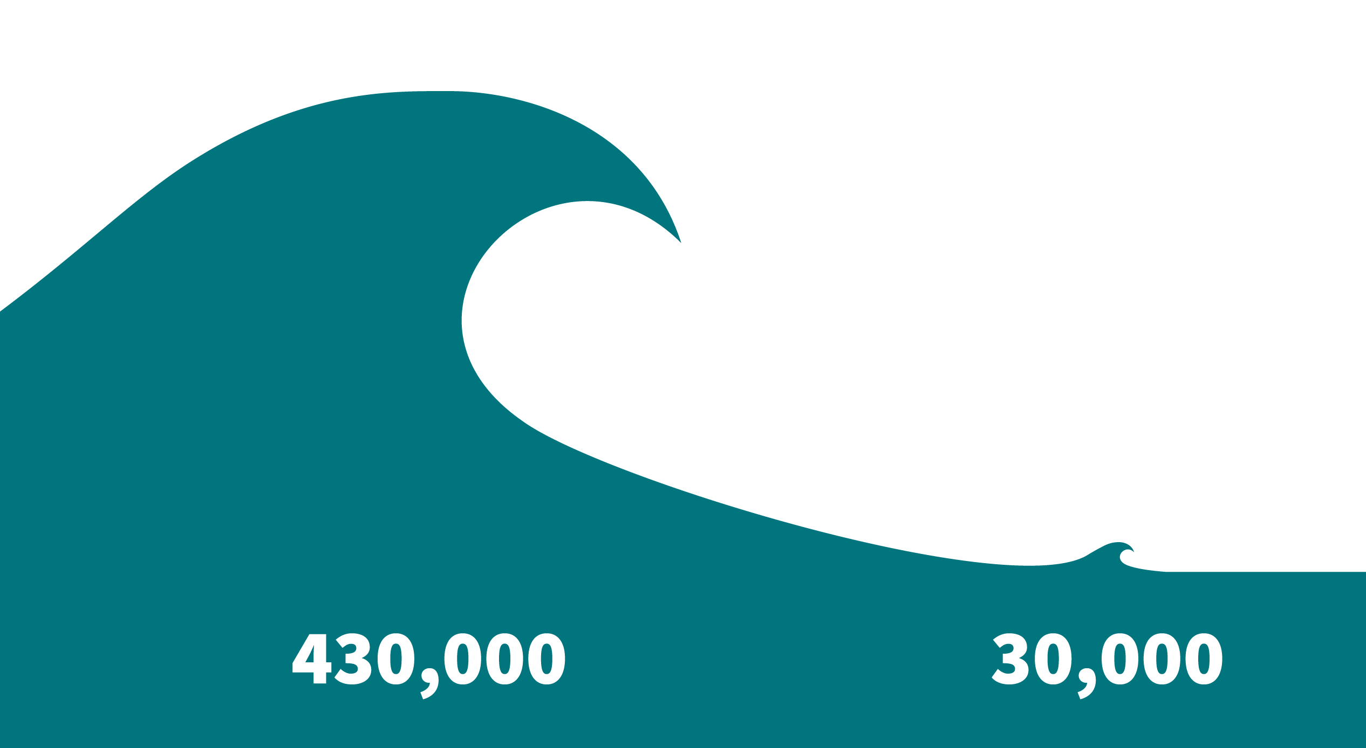

Slide 34
Further resources

Slide 35
Further resources
Websites:
www.ndis.gov.au
www.disabilityloop@afdo.org.au
Other resources:
Peer led disability organisations
Disability organisations for particular groups of people

Slide 37
Thank you for your valuable time

