Slide 1

NDIS CHAMPIONS:
EMERGING GRASSROOTS LEADERS
Training
Day 1

Slide 2

NDIS CHAMPIONS:
EMERGING GRASSROOTS LEADERS
Welcome
Matthew Wright, AFDO CEO

Slide 3

SESSION 1
Introduction

Slide 4


Introductions
Acknowledgement of Country
The AFDO Disability Loop project
Roll call

Slide 5
Workshop content
ACTIVITY:
Complete media consent form

Slide 6
Australian Federation of Disability Organisations
AFDO is a peak body.
Members are run and operated by people with a disability and their families.
AFDO represents the interests of people with a disability.

Slide 7




National Disability Insurance Scheme

Slide 8

Australian Federation of Disability Organisations
Disability Loop is a group of resources about the NDIS.
Disability Loop’s information is up-to-date, easy to find and easy to use. We always use plain language, to help you make sense of it all.

Slide 9

Training Agenda – Day 1
Session 01
Introduction
Session 02
Nuts & bolts of being a Champion
Session 03
All about accessibility
Session 04
Being a confident public speaker
Session 05
Preparing a 2 minute speech
Session 06
How did I go?
Session 07
Promotion and social media
Open forum
Questions

Slide 10
SESSION 2
The nuts and bolts of
being an NDIS Champion

Slide 11
What will NDIS Champions do?
Learn and use the NDIS speech
Use the NDIS and disabilityloop websites
Promote yourself and create opportunities
Help and support each other

Slide 12
The responsibilities of an NDIS Champion
Only use the information provided
It is OK to say ‘ I don’t know’
Keep your opinion to yourself
Be professional

Slide 13
The limitations of the NDIS Champion role
Champions are not NDIS employees
Champions operate in local communities
Payment by AFDO up to 31 October 2016

Slide 14
Getting paid – with an ABN
Tax invoice
All details
Email invoices to disabilityloop@afdo.org.au

Slide 15
Getting paid – without an ABN
Will be AFDO employee
Need Tax File Number
SACS Award Level 2 paypoint 3

Slide 16

Filling out forms

Slide 17
Employment contract
ACTIVITY:
Sign employment contract

Slide 18
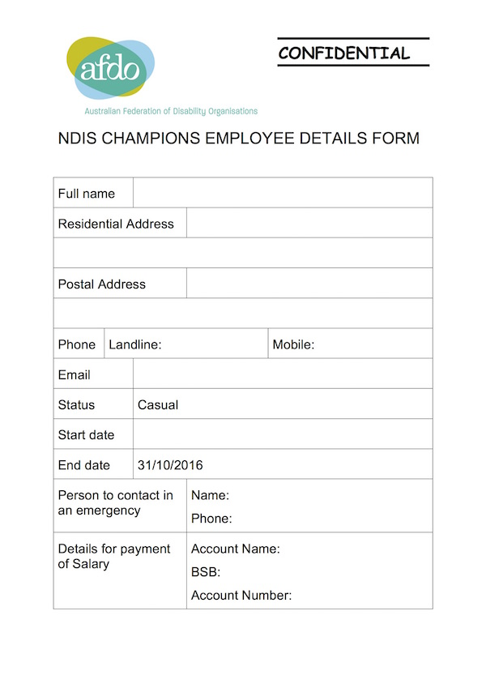
Employment details form
ACTIVITY:
Complete employee details form

Slide 19

Tax File Number Declaration form
ACTIVITY:
Compete and sign Tax File Number Declaration form

Slide 20
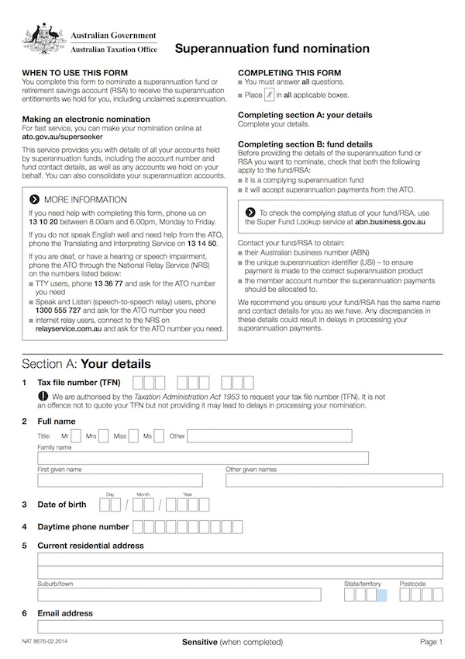
Superannuation fund nomination form
ACTIVITY:
Complete and sign Superannuation fund nomination form

Slide 21
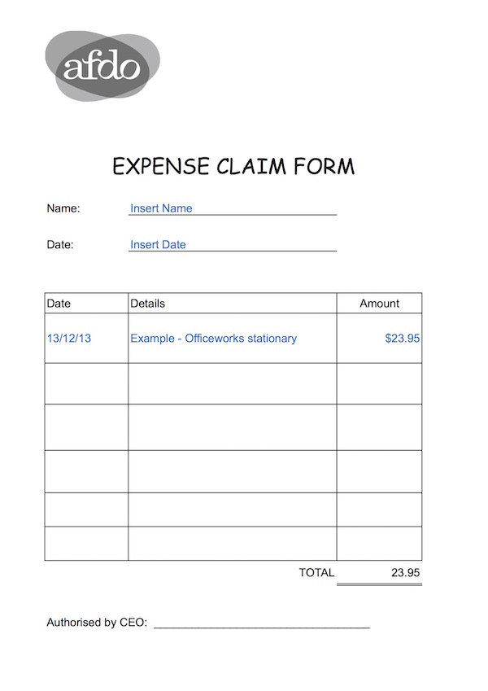
AFDO Expense form
ACTIVITY:
Fill out expense form if you have a taxi receipt/s for the trip to Melbourne

Slide 22
Filling out forms

Slide 23
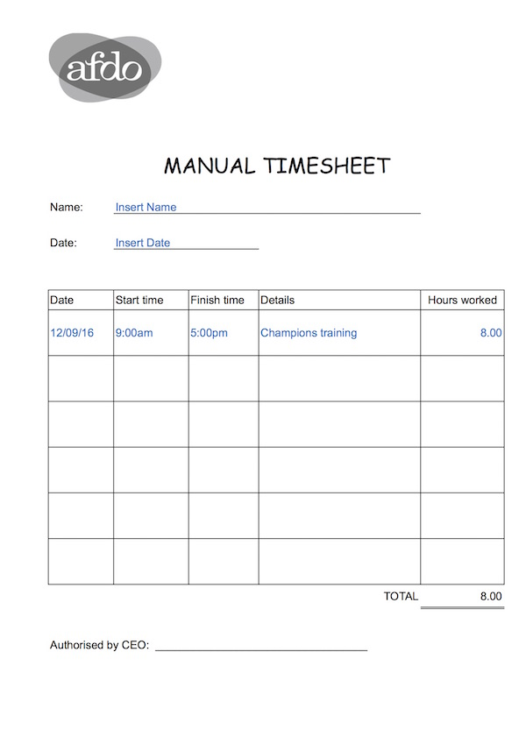
AFDO Timesheet
ACTIVITY:
Fill out the timesheet for the 16 hours of training

Slide 24
Work time
All training time plus any additional time required by AFDO
An hour of preparation time
Delivery of the presentation (one hour)
Unusually long travel or research time with prior written approval

Slide 25

Staying safe
Check for tripping hazards
Check in with family regularly
Have the contract name and number

Slide 26
Impact on the
Disability Support Pension

Slide 28
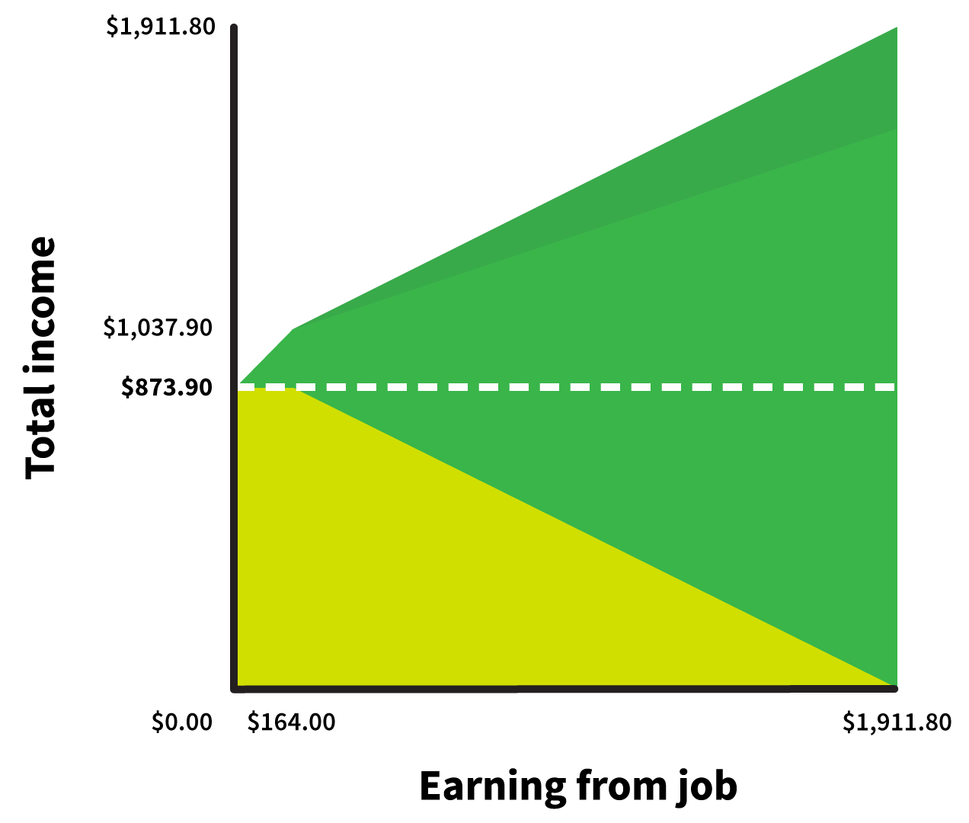

Slide 29
SESSION 3
All about accessibility

Slide 30

Accessible presentations
Top priority
Roll Call
AFDO approach to accessibility

Slide 31
SESSION 4
Being a confident public speaker

Slide 32
Jerry Seinfeld
“According to most studies, people’s number one fear is public speaking. Number two is death. Death is number two? Does that seem right? To the average person that means that if they have to go to a funeral, they’d be better off in the casket than giving the eulogy.”

Slide 33
Being adventurous
ACTIVITY:
How did you feel?
How did your heart feel?
What was your stomach doing?
Did it stop you from doing the things you like?
If you did go ahead, why?
How did you prepare?

Slide 34
Be Yourself

Slide 35
Be yourself
Speak the way you naturally do

Slide 36
Tips to build confidence
Tell people what you need
Speak to people, not at them
Nothing beats a personal story

Slide 37
Stella Young TED talk
https://www.ted.com/talks/stella_young_i_m_not_your_inspiration_thank_you_very_much?language=en

Slide 38
Be Yourself
ACTIVITY:
Let’s tell each other one thing that you really feel strongly about or something that makes you feel happy, or cross, and why.

Slide 39
Be Prepared

Slide 40
Be Prepared
Know your subject
Know what you are going to say
Know when you are going to say it
Know what you audience want to know about

Slide 41
Practice

Slide 42
Be Prepared
Practice
Practice hard words
Prepare technology and props
Know where you are going

Slide 43
Be Prepared
Arrive early
Know your contact person
Prepare your space

Slide 44
Ready to go

Slide 45
Ready to go
Act confident
https://youtu.be/qGaOlfmX8rQ?list=RDqGaOlfmX8rQ

Slide 46
Ready to go!
ACTIVITY:
Think about the songs that will make you feel good about doing a talk. It doesn’t have to any any type of song. It really has to be about feeling strong and happy with yourself.

Slide 47
Ready to go
Introduce yourself
Breathe
Remember people want to be there
Focus on the audience

Slide 48
Time Management

Slide 49
Time Management
How long should I speak?
Finding time balance
How do I know how long my speech will take?
Breaks

Slide 50
Time for questions
You set the rules
Question time tips

Slide 51
When things don’t go
to plan

Slide 52
Being confident
ACTIVITY:
In small groups, think about this session, and write down the most important things you have learned about being a confident speaker, and the tips you would use to help you look and feel more confident. Think about why they make you feel confident.

Slide 53


Slide 54
SESSION 5
Preparing a 2 min speech

Slide 55
How long is a 2 minute speech?
100 words per minute x 2 minutes = 200 words

Slide 56
Tricia’s 2 minute speech
My name is Tricia. I want to talk about why I am so passionate about going on a cruise. 19 words

Slide 57
I love that I can get on a ship and unpack my bags once.
I can get an accessible cabin which has hand rails and a shower stool, and the accessible cabins seem to be bigger than the other cabins.
I like that I can travel and see different places without all the drama of getting on and off in a place I don’t know, having to find accommodation and transport, and worrying about whether my luggage has arrived with me.
There are many things to do on board ships, such as relaxing by the pool or going to a show or meeting new people.
There are many options for dining and all the meals are provided, unless you want to go to one of the featured specialty restaurants.
If you want to exercise, you can swim in the pool, or go for a walk around the exercise deck, or go to the gym.
There are many shore excursions available and you can visit a number of different places. 169 words

Slide 58
Tricia’s 2 minute speech
I like cruises because I can drink because I won’t be driving. 12 words
TOTAL 200 words

Slide 59
Your 2 minute speech
ACTIVITY 1 – THE INTRODUCTION
Let’s write around 20 words for the introduction.
Here is a tip to start.
My name is…. I want to tell you about…....

Slide 60
Your 2 minute speech
ACTIVITY 2 – THE INFORMATION
Let’s think of seven sentences you could write about your subject. Have around 25 words per sentence.

Slide 61
Your 2 minute speech
ACTIVITY 3 – THE CONCLUSION
Now tell everyone what you have just said in one or two sentences. It only has to be 10 to 20 words long.

Slide 62
Your 2 minute speech
ACTIVITY 4 – REFLECTION
How did that feel?
Any questions?

Slide 63
SESSION 6
How did I go?

Slide 64
Getting feedback
Individual notes
Group notes
Formal evaluation sheets

Slide 65
How did I go?
ACTIVITY
In small groups, compose a list of questions that could be used to evaluate the training you are doing today.

Slide 66
Handling difficult issues
Difficult audience members
Difficult questions

Slide 67
SESSION 7
Promotion and social media

Slide 68
AFDO Promotion
National media release
Special edition of Disability Loop eNews
Social media action

Slide 69
Champion self-promotion
Talk to your networks – tell them you are available
Look for local opportunities
Use your own social media

Slide 70
Responsible use of
social media

Slide 71
Social media – responsible use
It’s public! Think twice
Respect copyright
Respect privacy
Be polite

Slide 72
Social media – responsible use
Use good judgement
Be clear that your views are your own
Be transparent
Be careful with use of logos

Slide 73
Social media – responsible use
Inappropriate comments could damage
  AFDO’s reputation
  A colleague’s reputation
  Your own reputation

Slide 74
Using social media
for promotion

Slide 75
Using social media for promotion
Links
Hashtags
Tagging
Sharing (retweeting, reposting etc)

Slide 76
Using social media for promotion
ACTIVITY
In small groups,
Come up with a Champions hashtag
Design a tweet to get the NDIS to retweet
Design a Facebook post to get people to visit your website

Slide 77
Thank you for your valuable time

